Slide 1
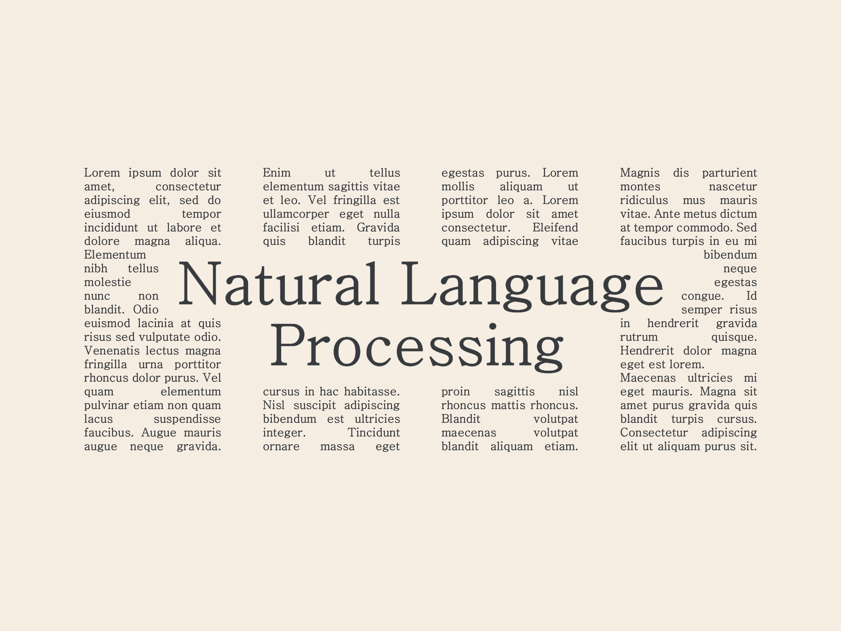


Slide 2
What is Natural Language Processing?
Field of Artificial Intelligence
Focused on semantic analysis of language
Understand language as it’s spoken or written
Numerous applications in Automation, Generative AI, Translation
Language tasks are murky, ambiguous, and complex
“I never said she stole my money.”
Exercise: Italicize different words in the phrase.
Each italicization changes the context.

Slide 3



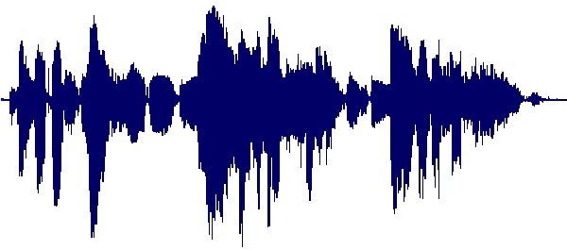

Applications of Natural Language Processing
Speech Recognition
Sentiment Analysis
Text Generation
Focused on identifying and transcribing spoken words into text. Models rely on waveform patterns and context clues to provide accurate transcriptions.
See: OpenAI Whisper
Provided an input, sentiment analysis models are capable of analyzing text and extracting emotion / connotations using context clues.
See: Examples
Provided a sequence of tokens, predict and generate new tokens in response to the context given. Chatbot models are a specific use-case of text generation fine tuned on Q&A style responses.
See: ChatGPT

Slide 4
Tokenization
The quick brown fox jumps over the lazy dog.
The process of splitting an input sequence into the smallest chunks of semantic significance.

Slide 5
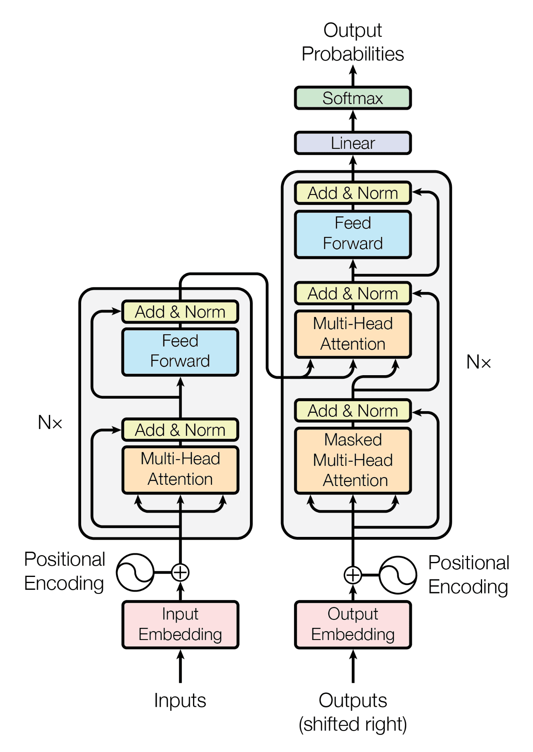
The Transformer Model
Architecture which allows the model to weight importance of different words in sequencing when processing
Helps to understand context of each word
Used in Machine Translation, Text summarization, Question answering, etc.

Slide 6




Today's Recipe: Large Language Models
Scrape the Web for Training Data
Use heuristics to select high quality training data from the web
Refine and Cleanse Text Corpus
Parse text and extract meaningful information, dropping markup tags, styling, etc.
Model Training
Crunch the numbers on your model weights using high-performance GPUs to train your transformer model.
Fine Tuning
A raw LLM is a next-word predictor, not a chatbot. Use human reinforcement and high-quality examples to refine your model for your use case.

Slide 7

Case Study: GPT-2
WebText: custom text corpus
Training Data: Hyperlinks accessible from Reddit posts with > 3 upvotes
~ 8 Million Documents or 40GB

Slide 8


Live Demo: LLM in 60 Lines with Python
https://github.com/ConnorUsaty/MacAIEducation2023

Slide 9


Slide 10



Thanks for Listening!

